Slide 1
Business Case for Service Based Tax Calculation
Alavara AvaTax

Slide 2
Current Challenges and Risks
High Transaction Volume
  65,000-77,000 orders annually (95.7% US, 2.4% Canada, 1.9% OTHER)
      ( INCLUDES 10K E-COMMERCE ORDERS )
  SYNCRONIZATION OF TAX RATES ACROSS TWO PLATFORMS (ERP/E-COMMERCE)
Manual Compliance Burden
  ACCOUNTING spends 25-30 hours/month on monthly filings
  Additional 5-10 hours quarterly (approx. 360-420 hours/year)
Error-Prone Processes
  Manual tracking of nexus thresholds across states/countries
  Risk of incorrect tax calculations and missed registration deadlines
Potential Financial Risks
  Penalties for non-compliance or audit errors
  High cost of manual corrections and customer refunds

Slide 3
Avalara Sales Tax Automation ROI
Financial Justification
  Annual Cost: $31K-37K subscription + $13K PRO SERVICES = $50K Year 1, 31K YEAR 2+
  (NOT NEGOTIATED YET)
  Labor Cost Savings: ~400 hours/year recovered (estimated value: $36K)
  Reduced penalties & audit risk: ESTIMATED $10K + annually (potential avoidance)
  RATE VARIANCE EXPOSURE: ~$5K ANNUALLY
Operational Efficiency
  Automated nexus threshold monitoring reduces errors
  Accurate real-time tax calculations integrated with existing ERP/e-commerce
  Scalable compliance supports future growth without additional staffing
Strategic Advantages
  Redirect customer service resources to higher-value activities
  Improve regulatory compliance, reducing audit risk
  Quick payback (estimated 1 YEAR) and long-term savings

Slide 4
Option: Tax Exemption Certificate Management
Challenge
  TRACKING OF VALID CERTIFICATIONS
Financial Justification
  ANNUAL COST: $2.5K
  TIME SPENT:

Slide 5
Appendix

Slide 6
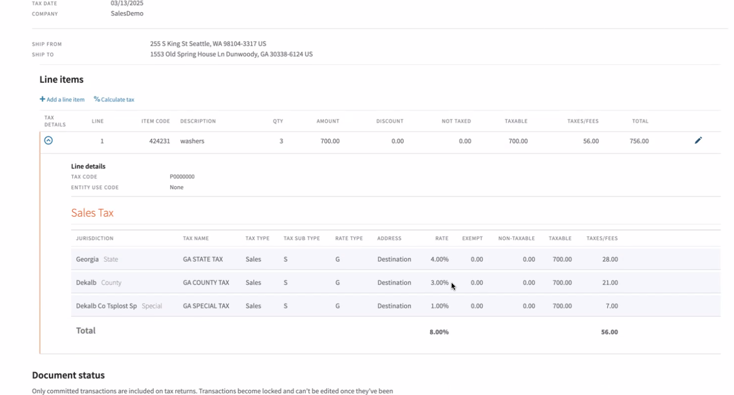
Complex Tax Rules by County and Product

Slide 7
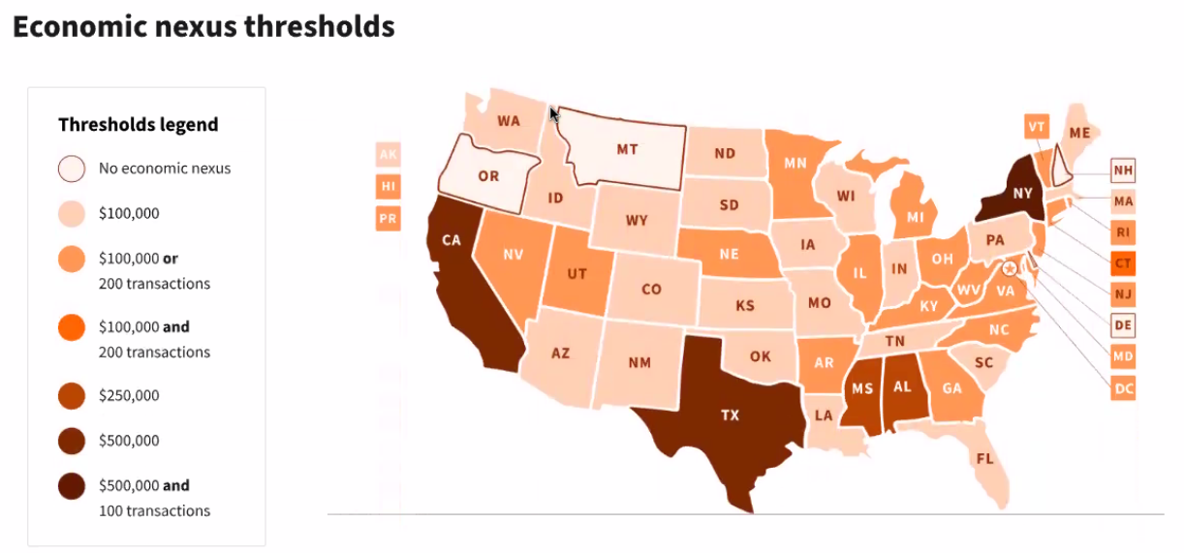
Tax Registration Threshold Reporting

